Slide 1
DATA VISUALIZATION
Interaction Operands and Spaces
User interaction plays an integral part in the effective visualization of data and information. Typical interaction operations include navigation, selection, and distortion.
A problem that can occur when these operations are specified using direct manipulation is determining which object or space is the focus of the interaction. In some operations the user wants to indicate a region of an image, while in others the focus might be the data being projected or the surface upon which the projection is occurring

Slide 2
INTERACTION
Interaction within the data and information visualization context is a mechanism for modifying what the users see and how they see it. In its basic form, navigation consists of panning and zooming allow the user to control the camera position and range of the view (what gets mapped to the screen).

Slide 3
INTRO
Parameters of the interaction operators described in the previous section are discussed in more detail later in the chapter.
An interaction operand is the section of space upon which an interactive operator is applied. To determine the result of an interactive operation, one needs to know within what space the interaction is to take place.
In other words, when a user clicks on a location or set of locations on the screen, what entities does he or she wish to indicate? Possibilities include the pixel(s), the data value or record mapped to the location, or even the component of the visualization structure (e.g., an axis) at or near that location.

Slide 4
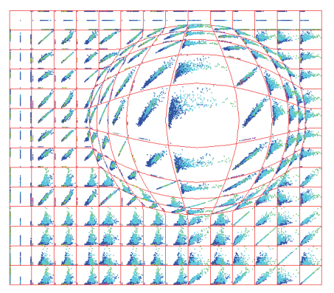
SCREEN SPACE
Navigation in screen space typically consists of actions such as panning, zooming, and rotation. Note that in each case, no new data is used; the process consists of pixel-level operations such as transformation, sampling, and replication.
In screen space techniques, pixel regions are enlarged or reduced to provide selective detail. In this scatterplot matrix display, a centre of focus has been selected and magnified using a confocal lens technique.

Slide 5
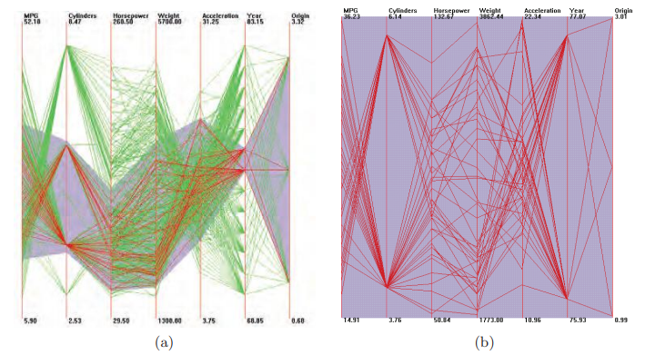
Data Value Space (Multivariate Data Values)
Navigating in data value space involves using the data values as a mechanism for view specification. The analogous operations for panning and zooming would be to change the data values being displayed; panning would shift the start of the value range to be shown, while zooming would decrease the size of this range.
Data value space selection is similar to a database query in that the user specifies a range of data values for one or more data dimensions. This can be performed via direct manipulation, as in the data-driven brushing reported in [249] (see Figure 10.5(a)) or via sliders or other query specification mechanisms [318]. Selection may involve a single value, or one or nonlinear ranges of values.

Slide 6
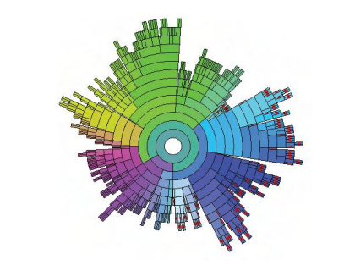
Data Structure Space (Components of Data Organization)
Data can be structured in a number of ways, such as lists, tables, grids, hierarchies, and graphs.
For each structure, one can develop interaction mechanisms to indicate what portions of the structure will be manipulated, and how this manipulation will be manifested.
Navigation in data structure space involves moving the view specification along the structure, as in showing sequential groups of records, or moving down or up a hierarchical structure (as in drill-down and roll-up operations).
Filtering is often performed in data structure space to reduce the amount of information on the display.

Slide 7
Attribute Space (Components of Graphical Entities)
Navigation in attribute space is similar to that in data value space; panning involves shifting the range of the values of interest, while zooming can be accomplished by either scaling the attributes or enlarging the range of values of interest. As in data value-driven selection, attribute-space selection requires the user to indicate the subrange of a given attribute of interest.
Similarly, if data records have attributes such as quality or uncertainty, a visual representation of these attributes, accompanied by suitable interaction techniques, can allow users to filter or emphasize data according to the attributes. Remapping is often done in attribute space, either via selecting different ranges of an attribute to be used in the data to graphic mapping, or by choosing a different attribute to be controlled by the data.

Slide 8
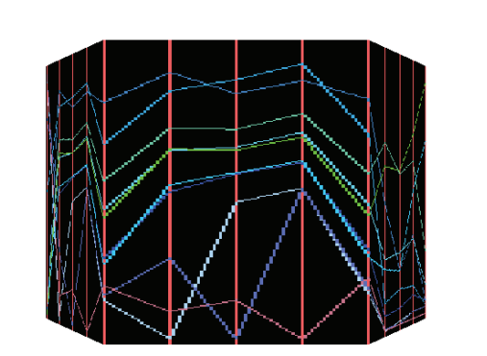
Object Space (3D Surfaces)
In these displays, the data is mapped to a geometric object, and this object (or its projection) can undergo interactions and transformations.
Navigation in object space often consists of moving around objects and observing the surfaces on which the data is mapped. The system should support global views of the object space as well as close-up views.
Remapping is often done in attribute space, either via selecting different ranges of an attribute to be used in the data to graphic mapping, or by choosing a different attribute to be controlled by the data.

Slide 9
A Unified Framework
Framework: In computer systems, a framework is often a layered structure indicating what kind of programs can or should be built and how they would interrelate.
Some computer system frameworks also include actual programs, specify programming interfaces, or offer programming tools for using the frameworks.
For each interaction operator to be applied to a specified space/operand, several parameters are required. Some of these may be constants for a given system.

Slide 10
Parameters
Focus:- The location within the space at the centre of the area of user interest. There may be multiple simultaneous foci, though for navigation this usually requires multiple display windows.
Extents:- The range within the space (can be multidimensional) defining the boundaries of the interaction. The metric used for specifying the range is specific to the space; in screen space this would be in pixels, while in structure-space this might be the number of rows in a table or links in a graph.
Transformation:- The function applied to the entities within the extents, generally a function of distance or offset from the focus. The shape of this transformation might also depend on the type of information being affected.
Blender:- How to handle parts of space touched by more than one interaction.

Slide 11
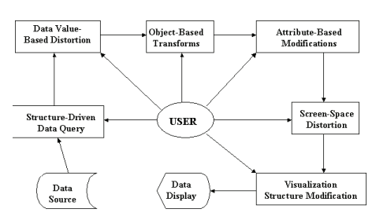
CONTD.
Pipeline depicting the structure of the generalized distortion process (similar figures can be generated for other forms of interaction). At each stage, the user can control any or all of the operator parameters described above.
While no system implemented to date supports all of these pipeline components, most visualization systems support one or more of them, allowing users interactive control over one or more of the operator parameters. It should be noted that the order in which the operations are applied may be modified, although the screen space method is most intuitively placed last.

Slide 12
INTERACTION CONTROL
At each stage of the pipeline introduced in the previous chapter, the user requires mechanisms to control the type, location, and level of each interaction as he or she navigates within both the data space and the visualization.
Focus selection:- Selection is most readily accomplished via direct manipulation tools, e.g., using a mouse or other selection device to indicate the focus location. In screen and object space, this can be easily accomplished via normal selection operations.
In data space, an n-dimensional location might need to be indicated. Depending on the method of display, this could involve multiple selections (e.g., selecting in a scatterplot matrix only enables simultaneous specification of two dimensions).

Slide 13
CONTD.
Extent selection:- Specifying the extents for an interaction is generally dependent on the type of interaction and the space in which the interaction is being applied, and can be done either via direct manipulation or separate interface tools. It may be specified via a single value (e.g., a radius or maximum number of items) or via a vector of values (e.g., a range for each data dimension or a set of constraints)
Interaction type selection:- Given the many types of interaction possible, and the variety of spaces in which they may be applied, a reasonable interface for this task would be a pair of menus: one to select the space, and the other to specify the general class of the interaction.

Slide 14
CONTD.
Interaction level selection:- The degree of interaction is an important control parameter that can be specified by a single value (e.g., the magnitude of scaling that will occur at the focal point). A slider or dial is sufficient for this activity, along with a button to reset the operation to its minimum level.
Blender type selection:- If more than one interaction can be simultaneously viewed and manipulated, there must be some mechanism for selecting a strategy for mixing regions of space affected by more than one interaction.

